Slide 1
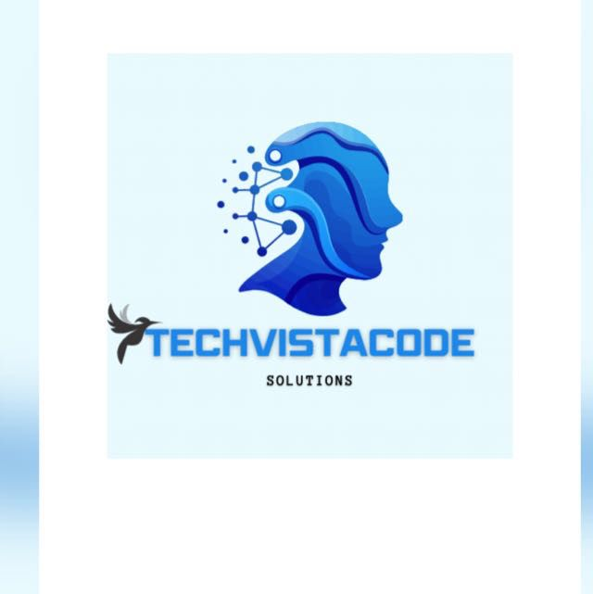
TechVista Code Solutions
Founder & CEO: Madiha Altaf Shaikh
City: Pune
Email: madihashaikh295@gmail.com
Mobile: 9021761300
One-Line Description: Comprehensive training and development for web applications, providing 100% job assistance globally.

Slide 2
Team
Madiha Altaf Shaikh
Role: CEO & Founder
Responsibilities: Training clients, developing websites, overall company direction.
Expertise: Extensive programming knowledge, experience in web and application development.
Equity: 70%
Ghufran Feroz Saudagar
Role: Manager & Co-founder
Responsibilities: Client management, requirements gathering, operational oversight.
Expertise: Management, client relations, operations.
Equity: 20%

Slide 3
The Issue or Pain Point
Customer Need: There is a significant demand for high-quality, up-to-date training in web application development.
Current Solutions: Many training programs offer outdated or generic courses without personalization or real-world job preparation.
Our Solution: We provide personalized, up-to-date training tailored to individual client needs, ensuring they are job-ready with 100% job assistance.

Slide 4
Product/Technology Overview
Uniqueness: Our training programs are highly personalized and updated regularly to keep pace with industry trends. We also offer real-world job preparation, including mock interviews and certifications.
Additional Services: We develop custom websites and applications for clients, ensuring a practical application of our training.

Slide 5
Business Model
Training Services: Clients pay ₹20,000 on average for personalized training programs.
Website Development: Clients pay between ₹5,000 to ₹25,000 for custom website and application development.
Job Assistance: 100% job placement services included in training programs.

Slide 6
Size of the Market Opportunity
Domestic Market (India):
Training: 100 clients x ₹20,000 = ₹2,000,000 per year.
Website Development: 50 projects x ₹15,000 (average) = ₹750,000 per year.
Global Market:
Training: 50 clients x ₹30,000 = ₹1,500,000 per year.
Website Development: 30 projects x ₹20,000 (average) = ₹600,000 per year.
Total Market Opportunity: ₹4,850,000 per year.

Slide 7
Current Traction
Achievements:
Successfully trained clients globally (India, Canada, USA, Australia, UK, Uganda, Dubai, Saudi Arabia, Sri Lanka).
Provided job assistance and placements.
Founder invited as a speaker at Symbiosis College and awarded for entrepreneurship at Aurora Tower, Pune.
Customer Base: Growing client base with a strong reputation for quality training and development services.

Slide 8
Competitive Landscape
Competitors: Online platforms like Coursera, Udemy, local training institutes.
Our Advantage:
Personalized and regularly updated courses.
Real-world job preparation and 100% job assistance.
Custom website and application development.
High client satisfaction and successful placements.

Slide 9
Financials Current and Projections
Current Year (2024):
Revenue: ₹2,500,000
CAPEX: ₹200,000 (Computers, software)
OPEX: ₹400,000 (Salaries, marketing, utilities)
Year 1 (2025):
Revenue: ₹4,000,000
CAPEX: ₹300,000
OPEX: ₹600,000
Year 2 (2026):
Revenue: ₹6,000,000
CAPEX: ₹400,000
OPEX: ₹800,000
Year 3 (2027):
Revenue: ₹8,000,000
CAPEX: ₹500,000
OPEX: ₹1,000,000

Slide 10
Funding Needs, Use of Funds & Proposed Valuation
Funding Required: ₹2,000,000
Use of Funds:
Hiring additional trainers: ₹800,000
Office rental and setup: ₹500,000
Marketing: ₹500,000
Technology upgrades: ₹200,000
Fund Utilization: Funds will last 12 months, enabling us to expand our team, establish a physical office, and enhance our marketing efforts.
Follow-on Capital: Additional ₹3,000,000 planned for Series A round after 12 months for further expansion.
Valuation Sought: ₹10,000,000

Slide 11
Current Equity Structure, Fundraising History, and Investors
Current Equity Structure:
Cap Table:
Madiha Altaf Shaikh (Founder & CEO): 70%
Ghufran Feroz Saudagar (Manager & Co-founder): 20%
Contract-based employees: 5%
Reserved for future hires: 5%
Amount of Money Invested So Far:
Founder’s Investment: ₹300,000
Investment in computers, software, certifications, and knowledge.
Additional Investments:
Time and Expertise: Significant contributions from founders.
Certificates and Knowledge Acquisition: Enhancing service quality and credibility.

Slide 12
Exit Options
Acquisition by a Larger Company:
Potential acquirers include large tech companies or educational technology firms.
Strategic Partnerships and Buyouts:
Strategic partnerships with bigger players in the tech and education industry.
Private Equity Buyout:
Private equity firms interested in scalable and profitable businesses.
Initial Public Offering (IPO):
Going public in the long term as the company grows and captures substantial market share.
Employee Stock Ownership Plan (ESOP):
Allowing employees to buy shares in the company.
Comparable Exits in the Industry:
Great Learning’s Acquisition by Byju’s: Acquired for $600 million in 2021.
Simplilearn’s Sale to Blackstone: Acquired for $250 million in 2021.
Pluralsight’s Acquisition by Vista Equity Partners: Acquired for $3.5 billion in 2020.

Slide 13
Achievements, Certificates, and Client Feedback
Achievements:
Invited as a speaker at Symbiosis College and awarded for entrepreneurship at Aurora Tower, Pune.
Certificates:
Various certifications in programming and web development technologies.
Client Feedback:
Positive feedback from clients across India, Canada, USA, Australia, UK, Uganda, Dubai, Saudi Arabia, Sri Lanka.

