Slide 1
Scholar

Slide 2
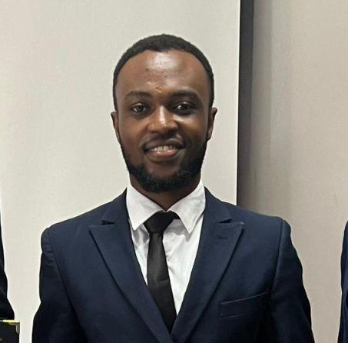
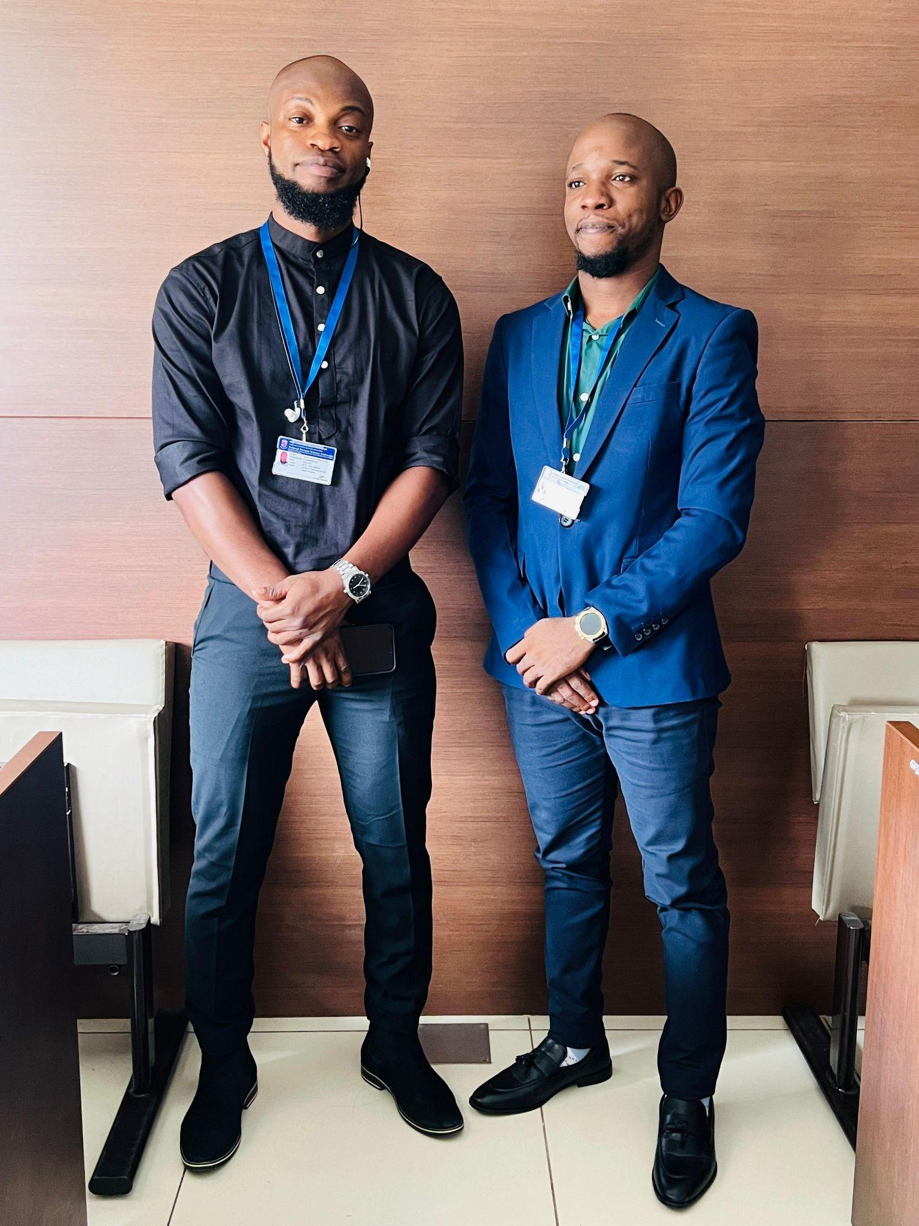

Team
Emmanuel William Frimpong
Daniel Wayne Amewu
Khalid Nur Ali
Co-founder
Mobile Dev
Co-founder
Backend Dev
Co-founder
Web Dev

Slide 3
Problem
In today's fast-paced and competitive environment, individuals often face significant challenges in effectively preparing for important evaluations.
Key issues include:
Lack of Focus and Direction.
Inadequate Simulation of Real Scenarios.
Anxiety in Oral Evaluations.
Notes:
In today's fast-paced and competitive environment, individuals often face significant challenges in effectively preparing for important evaluations. Key issues include:
Lack of Focus and Direction: People frequently struggle with identifying key areas to concentrate on, leading to inefficient preparation and wasted time.
Inadequate Simulation of Real Scenarios: Traditional preparation methods often fail to replicate the pressure and format of actual evaluations, leaving individuals unprepared for the real experience.
Anxiety in Oral Evaluations: The oral component, such as viva exams or interviews, is a source of anxiety for many, who lack opportunities for realistic practice and feedback.

Slide 4
Product
Our app aims to revolutionize the way individuals prepare for evaluations by leveraging Large Language Models (LLMs) to address these pain points with the following features:
Personalized Preparation Plans
Simulated Real-World Scenarios
Oral Evaluation Simulation
Notes:
Our app aims to revolutionize the way individuals prepare for evaluations by leveraging Large Language Models (LLMs) to address these pain points with the following features:
Personalized Preparation Plans: Utilizing LLMs, the app will analyze a user's goals, background, and performance data to generate personalized preparation plans that highlight key focus areas, ensuring efficient and effective preparation.
Simulated Real-World Scenarios: The app will use LLMs to create a wide range of simulations, from multiple-choice questions and timed written tests to interview scenarios. These simulations will replicate the exact format and pressure of real evaluations, adapting to the user's progress to provide increasingly challenging scenarios.
Oral Evaluation Simulation: An interactive module powered by LLMs will allow users to participate in simulated oral evaluations, such as viva exams or job interviews. The AI-driven virtual examiners will provide realistic questioning and detailed feedback, helping users build confidence and reduce anxiety.

Slide 5
Business model
-Token based model where the users will have different benefits according to the tokens they purchase

Slide 6


Market
Students and professionals
Notes:
Our market base is mainly students and professionals who are trying to study and make the most of the time they have

Slide 7
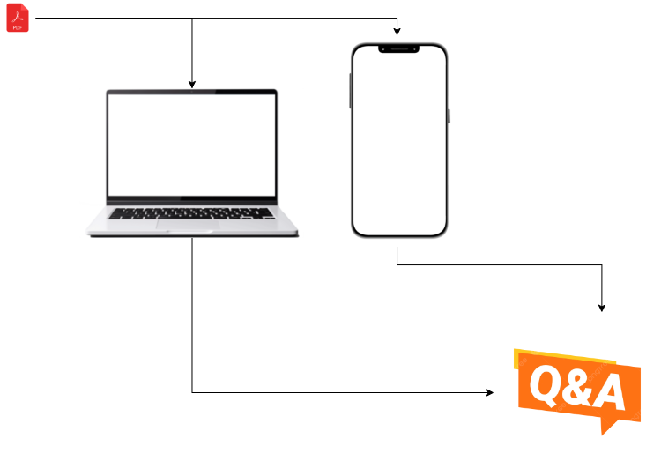
Traction
Basic Prototype

Slide 8

Competitive landscape

Slide 9
Current finance and projection
Current - $0
Modest - $1000
Highest -$3000

Slide 10
Funding needs
$3000 for kick starting the project

Slide 11
Exit strategy
Best case scenario - IPO
Realistic - Make enough money to return initial investment plus revenue
Worst - Stay a startup

