Slide 1
SPOT
BOARDS
Pitch Deck
Presentation

Slide 2
SPOT BOARDS
9025062008
CONTACT US
Chennai, India
spotboards173@gmail.com

Slide 3
OUR
COMPANY
This project aims to design and implement a mobile application dedicated to simplifying the process of finding and leasing billboard advertising spaces for businesses and advertisers.
Spotboards revolutionizes the billboard advertising landscape by empowering advertisers and location scouts with a user-friendly mobile application for locating available billboards.
It is on a mission to bridge the gap between the physical and digital worlds of billboard advertising.

Slide 4
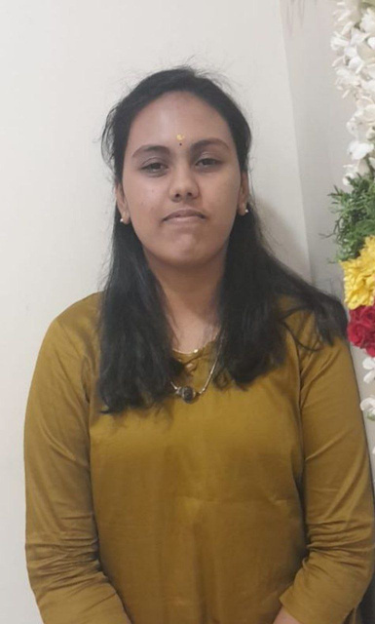
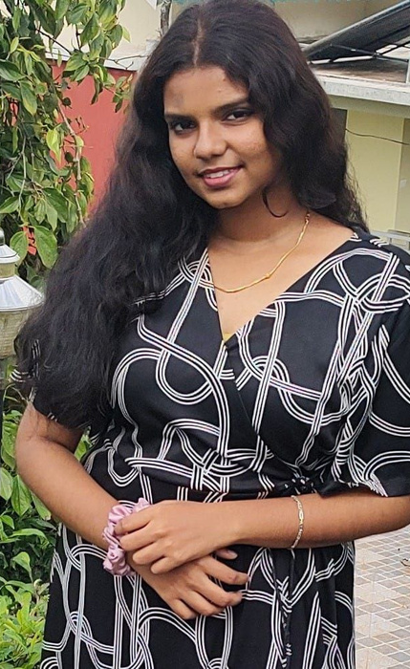
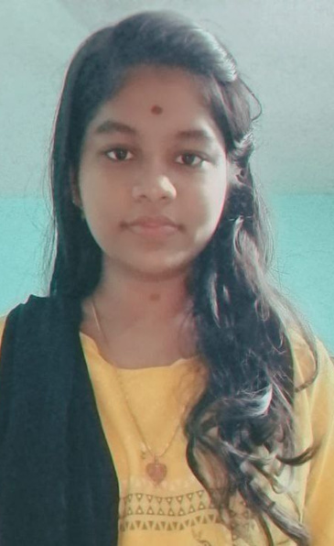
MEET OUR TEAM
VANATHI LAKSHMI J K
VISHNUPRIYA S
SUSAN REBEKAH
SELVADHARSHINI
VAISHNAVI M
FOUNDER AND CEO
DATA AND FINANCIAL ANALYST
CONTENT AND MARKETING MANAGER
UX/UI FRONTEND MANAGER
CUSTOMER SUPPORT MANAGER

Slide 5
Pain Points addressed by SPOTBOARDS
Time-Consuming Process: Offline booking often involves lengthy negotiations and manual processes. Spotboards streamlines this with an online platform for quick and efficient bookings.
Lack of Transparency: Traditional methods can lack transparency in pricing and availability. Spotboards provides clear, real-time information on available spaces and costs.
Limited Reach: Offline methods may restrict advertisers to local contacts and networks. Spotboards offers a broader selection of billboard locations, accessible from anywhere.
Inefficient Management: Managing multiple billboard bookings manually can be cumbersome. Spotboards centralizes the management of all bookings in one place.
Difficulty in Comparison: Comparing different billboard options offline can be challenging. Spotboards allows users to easily compare locations, sizes, and prices.
Communication Delays: Offline booking often involves back-and-forth communication, leading to delays. Spotboards facilitates direct and instant communication between advertisers and billboard owners.

Slide 6
PRODUCT
Centralized Platform: Spotboards offers a one-stop solution for finding and booking outdoor billboards, permanent banners, and digital billboards. This centralization simplifies the process, making it more efficient than traditional methods.
Real-Time Availability: The platform provides real-time updates on the availability of advertising spaces, ensuring users have the most current information, which reduces uncertainty and enhances planning.
Transparency in Pricing: Spotboards brings transparency to the pricing structure, allowing advertisers to make informed decisions based on clear, upfront costs without hidden fees.
Broad Selection: Users can access a wide range of billboard locations across different regions, offering greater flexibility and choice compared to local, offline methods.
Efficiency and Speed: By automating and digitizing the booking process, Spotboards significantly reduces the time and effort required, enabling faster campaign launches.
Direct Communication: Spotboards facilitates direct communication between advertisers and billboard owners, reducing the delays and miscommunications often associated with offline negotiations.
Secure Payments: Integrated payment solutions on Spotboards offer secure and convenient transactions, streamlining the financial aspect of billboard booking.
OVERVIEW

Slide 8
SIZE OF MARKET OPPORTUNITY
For the SpotBoards project, the revenue breakdown is as follows
1. Total Revenue: ₹12,00,500
- This represents the overall revenue generated by combining all revenue streams.
2. Commission Revenue: ₹2,500
- This revenue comes from commission fees.
- Calculation: The total commissionable amount is ₹25,000.
- Commission Rate: 10%
- Commission Revenue Calculation: ₹25,000 × 10% = ₹2,500
3. Subscription Revenue: ₹11,98,000
- This revenue is generated from subscription fees.
- Number of Subscriptions: 2,000
- Price per Subscription: ₹599
- Subscription Revenue Calculation: 2,000 subscriptions × ₹599 per subscription = ₹11,98,000

Slide 9
Current Traction
Achievements to Date:
- Currently, Work is ongoing to establish the project's initial phases.
Product, Customers, Revenues:
- As of now, the project is in the early stages, with no products launched, customers acquired, or revenue generated.
Visuals:
- There are no available photographs or visual materials at this time.
This section will be updated as the project progresses and milestones are reached.

Slide 10
COMPETITIVE LANSCAPE
Traditional Companies
Spot Boards
Traditional outdoor advertising companies are our primary competitors. While they may possess internal data on billboard locations, they often lack a centralized platform. This results in time-consuming, manual processes to access and utilize this information.
Spotboards differentiates itself by offering a centralized, user-friendly platform that streamlines the process of finding and booking billboards and permanent banners. To date, no other online platform provides this comprehensive service, positioning us as pioneers in the industry.

Slide 11
Financials Current and Projections:
Android Development and Apple ios(1,00,000 per year), App/Play store(15,000 per year) ,
Maintanence(2,00,000 per year),
Cloud and API supports( 2,00,000 per month) and Miscellaneous (50,000 per month)

Slide 12
FUNDING NEEDS, USE OF FUNDS & PROPOSED VALUATION
Android development and appleios(2,00,000 per year),
App/play store(15000 per year)
Funding Needs and Valuation
To bring our billboard locator app to life, we require the above in funding. This investment will cover the costs of app development for both Android and iOS platforms, including essential app store fees. We've also allocated a contingency budget to handle unexpected challenges during development.
Additionally, we plan to invest in a robust marketing campaign to generate initial traction and user acquisition. To support our team's efforts, funds will be allocated for salaries, equipment, and software licenses.
While determining an exact valuation at this early stage is challenging, we believe our innovative solution and potential market size warrant valuation. We are open to discussing various investment structures, including equity, debt, or a combination of both.

Slide 13
CURRENT EQUITY STRUCTURE, FUNDRAISING HISTORY, AND INVESTORS
Current Equity Holding (Cap Table)
- The equity structure is currently being finalized and will be detailed once it is established.
Personal Investment:
- No personal investment has been made to date.
Previous Investment History:
- There is no previous investment history at this time.
Further details will be provided as the equity structure and investment activities progress.

Slide 14
EXIT OPTIONS
Merger with a Complementary Business
Strategic Acquisition
A strategic acquisition by a major outdoor advertising company presents the most promising exit for our business. These industry giants possess extensive resources, distribution networks, and established client relationships that can significantly amplify our platform's impact.
A data and analytics firm could be interested in acquiring our platform to enhance their location data capabilities and offer more comprehensive solutions to their clients.
Joining forces with a like-minded company can be a powerful growth strategy. By combining our platform's strengths with another company's complementary offerings, we can create a more comprehensive solution for our customers. This strategic partnership can unlock new markets, share resources, and accelerate growth.
Acquisition by a Data and Analytics Firm

Slide 15
THANK YOU

