Slide 1

Pitch Deck: Rent It All
UptoSkills Start-Up-Thon

Slide 2

About us
Chennai | rentitall2508@gmail.com | +91-9849116150
URL: https://fordriveonly39.wixsite.com/rent-it-all
At Rent All, we aim to convince people to rent products rather than buy them. These products may be something they use everyday, or something they use once in a while. While doing so, we aim to promote sustainability and host an environment friendly service which reuses items.
Notes:
Talk about the logo a bit

Slide 3
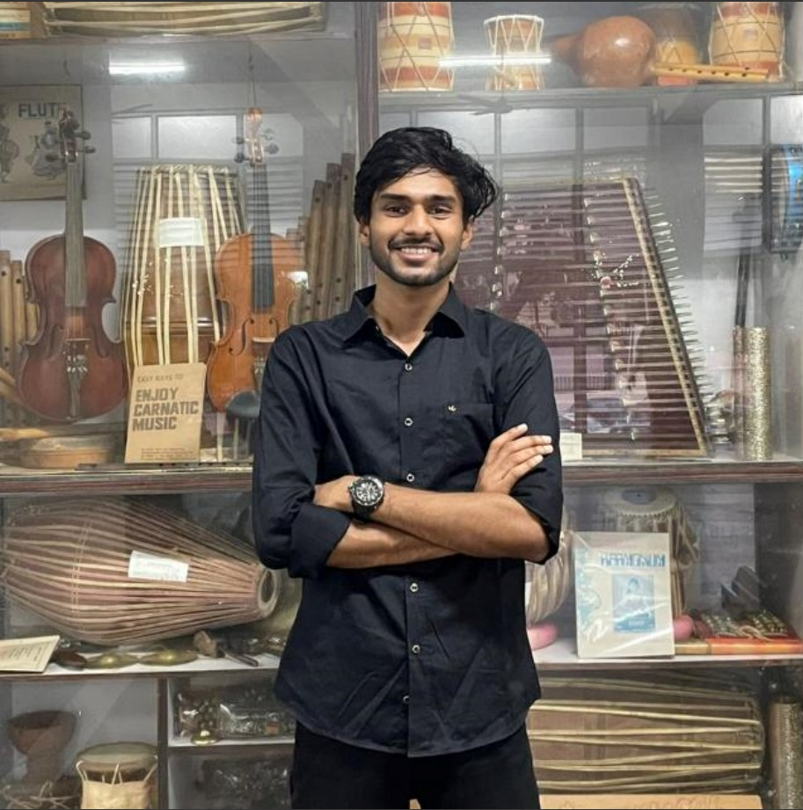


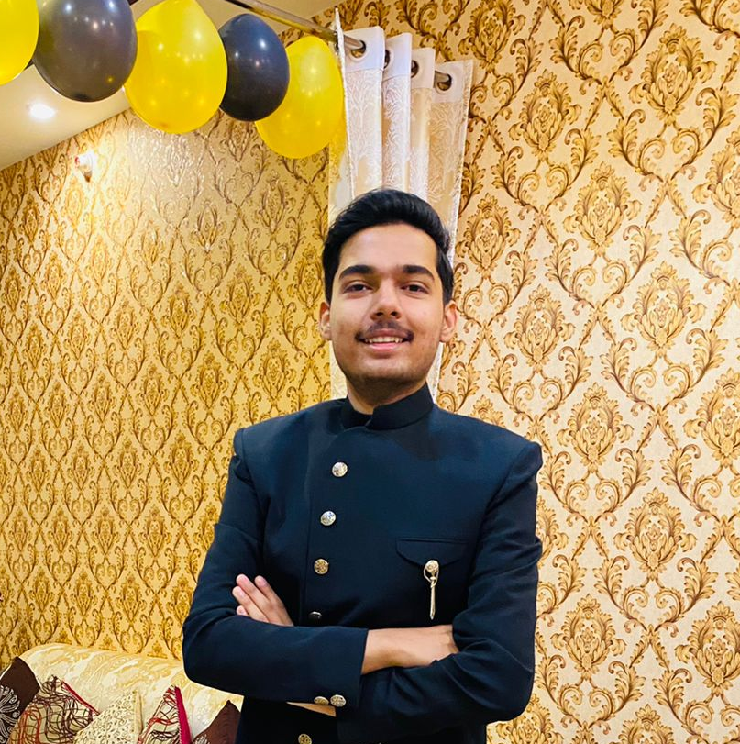

Our Team
Atharv Agarwal
Vishesh Jain
Juhi Khaitan
Brahmansh Dwivedi
Priyanshu Ajitsaria
Chief Financial Officer
Equity: 15%
Chief Marketing Officer
Equity: 15%
CEO/ Founder
Equity: 35%
Chief Technical Officer
Equity: 15%
Chief Operating Officer
Equity: 15%

Slide 4

Problems
Forgetful Nature
Forgot your umbrellas during rains? Or a simple sewing kit for that loose button on your shirt? Don’t worry, we’ve got you!
Customers
65% of customers buy items they will only use once or out of impulse. This not only harms their wallet, but also the planet.
Humanitarian Effort
We want to connect hearts and encourage a continuous system of sharing.

Slide 5




Solution
One-Stop Solution
Target audience
Cost savings
Recycling
Our company makes it easier for you to rent items like hot water pads, umbrellas, etc. by checking our website and then collecting from kiosks closest to you
Crochet kits for bored grandmas, Hairdryers for travelling passengers and Electric kettle for late night meals with friends in college
Reduces expenses for you, because you rent the items at a lesser price than you buy
Saving the environment by not trashing items after single use. We give the products a new life in someone else’s home.

Slide 6


Product benefits
1.
Renting is always cheaper than buying. A completely need based system of borrow and lend.
2.
Saves storage place in a customer’s home.
3.
Has a high target audience (due to the locations and items on the kiosk) and draws in people from all age groups.

Slide 7



Business model
Impulse Buyers and
Single Use Items
Our USP
Effective Market Plan
A 2018 survey by Slickdeals found that Americans spend an average of $5,400 annually on impulse purchases. Many of these purchases are often for items that are used infrequently and could be rented instead.
We offer competitive pricing based on item and duration and can also offer subscription based plans to regular renters.
We can reduce costs by buying second hand items and refurbishing them. In the future, we can also make an interconnected web of borrowing and lending.

Slide 8
Our Competition (Current & Future)
Our company is in the renting business & it seems to be a novel and unexplored idea at the moment.
For this reason, we have very few to almost no competitors
Direct Competitors: Established companies that offer rental services for specific categories like tools, equipment, or party supplies like Rent All Services in the US for furniture and appliances.
Online Rental Platforms: Websites and apps offering a wide range of rental items, similar to Rent It All.
Indirect Competitors: Second-Hand Marketplaces on platforms like eBay or Craigslist where people buy and sell used items.
Subscription Services: Services offering item subscriptions (e.g., clothing, electronics) which provide an alternative to ownership like Myntra in India.
Future Competitors: Traditional retailers entering the rental market to offer their products as rentals.
Tech Giants: Companies like Amazon expanding into rental services.

Slide 9
Growth strategy
How our company will unfold upon starting
Month 1
Month 2
Month 3
Month 4
Month 5
Month 6
Establishing a list of products to be kept.
Beginning of, initially through Marketing Phase social media, video ads, etc.
Going LIVE!
Opening Kiosks at malls, airports, stations, apartment blocks.
Month 7
Month 8
Month 9
Month 10
Month 11
Month 12
Gathering feedback from the community
Increasing product and kiosks catalogue to include customer-requested products

Slide 10
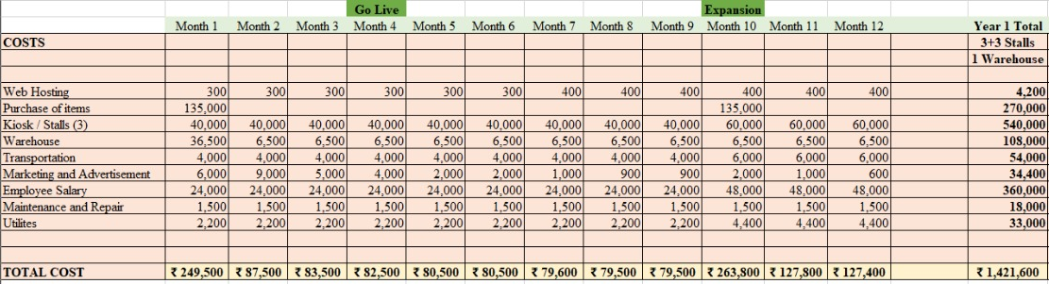
Expected Expenditure in the 1st Year
(Month Wise)
GST Laws for Start-ups are close to non existent, having no GST registration for companies with a turnover less than Rs. 50 Lakhs.

Slide 11
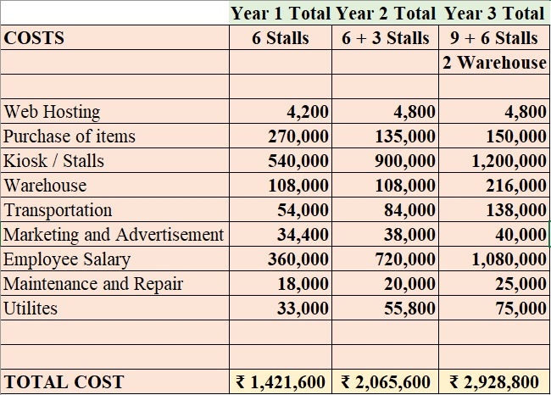
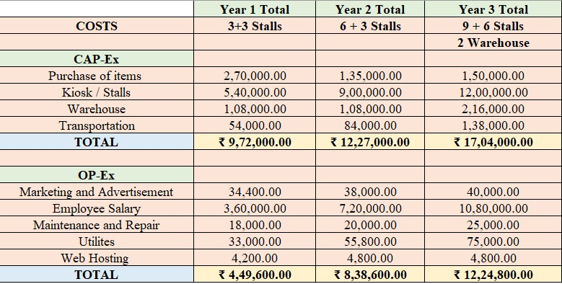
Financial Expenditures
(An Analysis of 3 Years)
Consolidated 3 Year Expenditure
Dispensation of Expenses in CapEx and OpEx

Slide 12
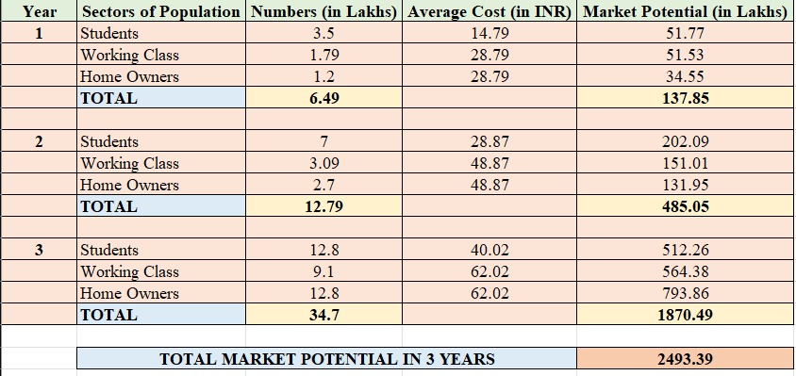
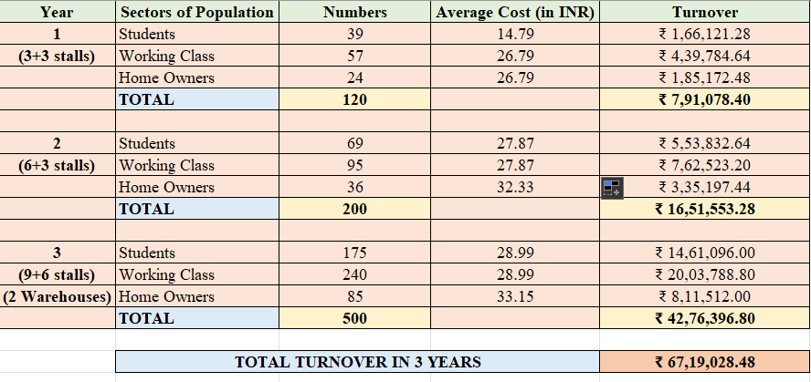
Use of Funds & Proposed Valuation
We ask our investors to invest Rs. 30 Lakhs in our business in exchange for an equity of 5% in our company for 3 years.
We propose the following evaluation against the Market Potential of our company in the renting industry (top table).
With this, we will be able to get to about 500-1000 customers in the 3 years and about Rs. 1 Crores in revenues (bottom table).
We would not require a follow-up investment as our business will be carried forward by our profit margins.

Slide 13
Exit Strategy for Our Investors
Mergers with Similar Objective Businesses: Merge with other rental platforms or tech firms for synergies and expansion.
Example: Spinlister merged with Liquid to expand their network.
Initial Public Offering (IPO) Public Listing: One of the key factors for IPOs being a preferred route of exit is investors getting access to public markets, which also ensures free transferability of shares.
Moreover, if the company has experienced significant profits, IPO allows the company to expand through the public, expanding it’s operations across nations.
Example: Companies like GoDigit, ixigo and Fintech have recently shifted from Investors to IPO Listing on market
Secondary Sale of Shares: Existing investors sell shares to new private investors. This allows the investors to exit safely, trusting their equity to a new Investor and also allows the company to retain a constant source of investment and guidance.
Example: Many private companies offer shares to their trusted and position holding employees for their continued loyalty and service to the company.

Slide 14

Future Plans
1.
To make an interconnected web of people borrowing and lending from each other. Convenience for one, Income for the other.
2.
Make some products be available on selected days and on demand thus increasing the catalogue.
3.
Opening similar stores all over the world.

Slide 15

Thank
You
Team Members:
Juhi Khaitan
Brahmansh Dwivedi
Atharv Agarwal
Vishesh Jain
Priyanshu Ajitsaria

