Slide 1
- Jobs as Services
Streamlining job searches through direct worker-employer connections.
Email - prashant.dev.701@gmail.com
Mobile - +919306032860

Slide 2
The Team
Driven by the frustration of recent graduates facing a challenging job market, we created a platform to directly connect skilled individuals with potential employers.
Prashant
Kaushik
MCA, NIT Calicut
Handles - Tech, Operations
Founder
Equity - 100%
MCA, NIT Calicut
Cross-platform Mobile Application Developer
Employee

Slide 3
The problem
Despite a demand for low-skilled workers by households and corporations, these positions remain unfilled.
Job search platforms are ineffective for many because they lack the qualifications for "office" jobs, resulting in 7 Crore unemployed people in India.
Workers typically seek jobs through conventional methods where employers post job openings, and job seekers must continuously search and apply, often waiting for these positions to be filled.

Slide 4
The solution
OCCUPY addresses the problem of unemployment and the difficulty of filling low-skilled positions by providing a platform that connects workers and employers directly.
Users list the types of work they can perform, making it easier for households and corporations to find and employ low-skilled workers.
Employers search for required services and interact with selected workers through chat or call, facilitating clear communication.

Slide 5
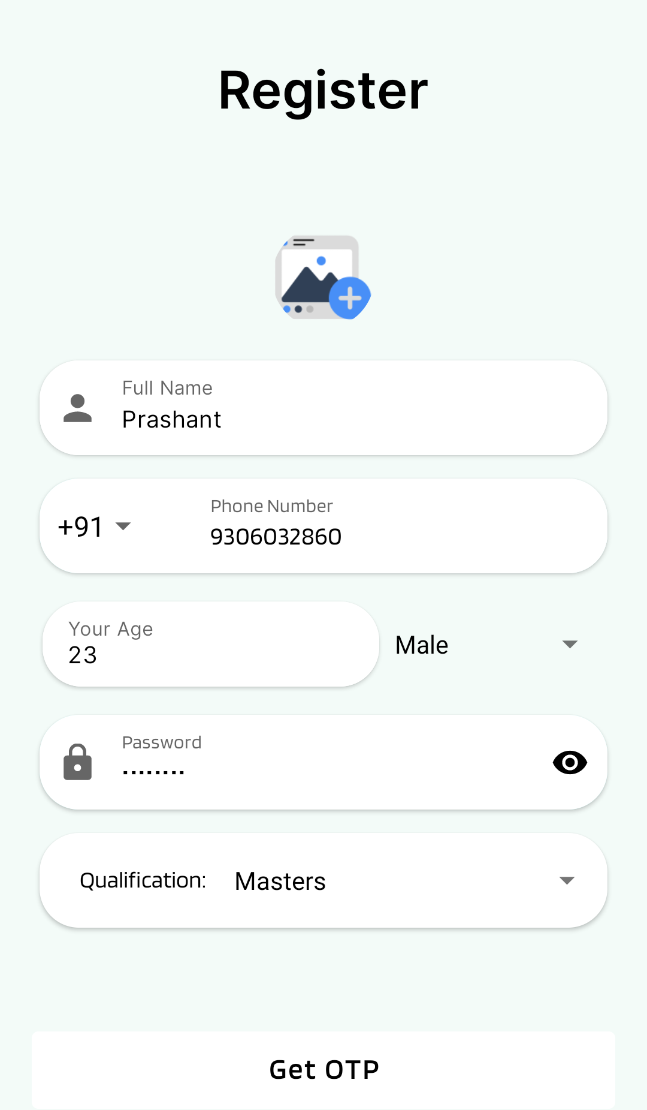
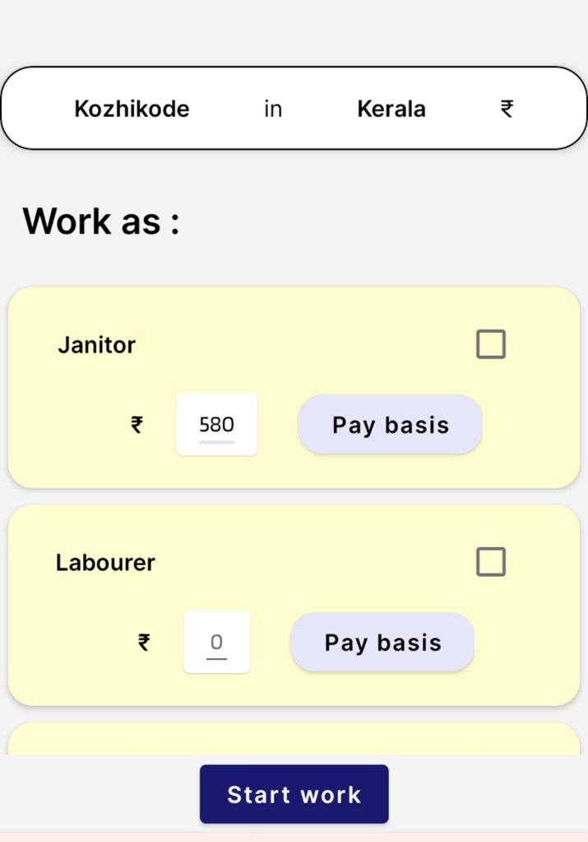
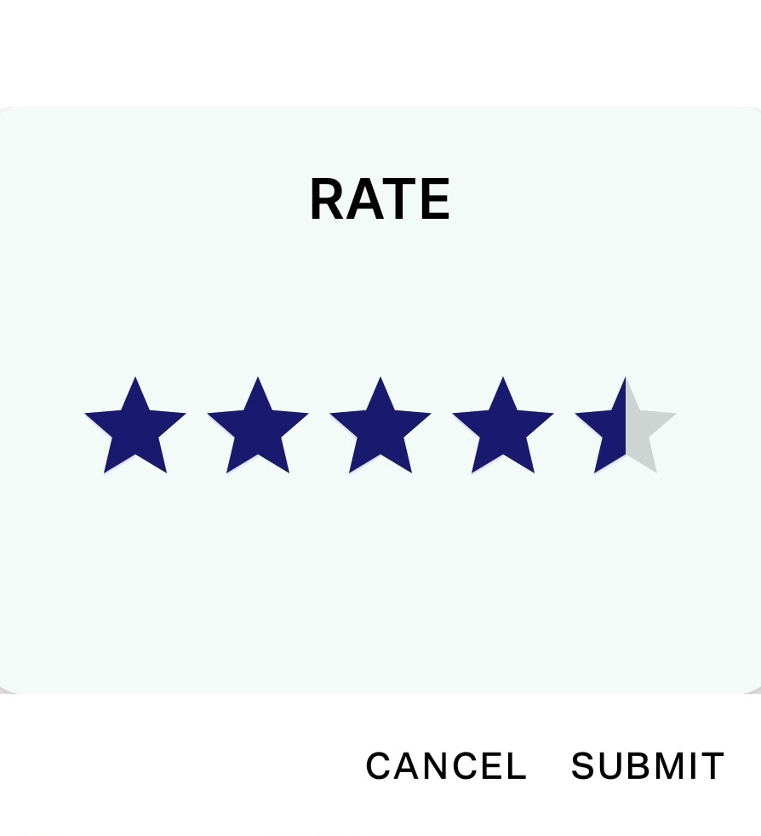
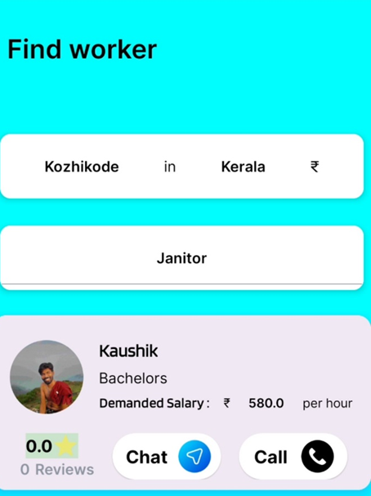
How it works
Step 3
Step 4
Step 1
Step 2
Employer rate the worker afterwards
Worker publish the kind of work they can do
Buyer or Employer search for workers and contact them
User register with their Phone

Slide 6
Business Opportunities
Targeted In-App Advertising:
Implement targeted advertising for products related to user interests, such as showing gardening tools to users interested in gardening services.
Data-Driven Revenue Generation
This platform harnesses valuable user data to create detailed audience profiles. By partnering with businesses like market research firms and advertising agencies, we aim to generate significant revenue while safeguarding user privacy.

Slide 7
Business Opportunities (Post User Growth)
Corporate Partnerships:
Partner with top-rated workers, offering them contracts and salaries to meet the manpower needs of large corporations.
Collaborations with Recruitment Companies:
Work with recruitment firms to advertise their workers on the platform, enhancing the pool of available talent.
In-App Subscriptions for Workers:
Offer subscription plans for workers to boost the visibility of their services, increasing their chances of being hired.

Slide 8
Size of the market opportunity
Countries with abundant low-skilled labor, such as India, Canada, UK, and Australia.
In India (as per 2022-23 PLFS):
Low-skilled Force : 58% (64 Crore)
Unemployed Labour Force : 5.1% (7 Crore)
Canada (as per 2021 Occupational Distribution):
Low-skilled Force : 36% (62 Lakh)
Unemployed Labour Force : 6.4% (25 Lakh)
Australia (as per 2024 Occupational Distribution):
Low-skilled Force : 66% (1.7 Crore)
Unemployed Labour Force : 4% (10 Lakh)
United Kingdom (as per 2024 Occupational Distribution):
Low-skilled Force : 74% (1.7 Crore)
Unemployed Labour Force : 4% (10 Lakh)

Slide 9
Milestones
January 2024
June 2024
October 2024
March 2024
Aug 2024
Researching for job search solution
Finalized Product with purchased servers
Marketing Published Product
Jan | Feb | Mar | Apr | May | Jun | Jul | Aug | Sept | Oct | Nov | Dec
Developed first prototype
Started Legal formalities to register Corporation

Slide 10
Competition
Urban Company :
Similarity : Sell low-skilled services through their platform.
Differences and their limits:
Urban Company's business model is heavily reliant on a centralized workforce. This necessitates significant investments in recruitment, training, and management, restricting rapid expansion beyond major metropolitan areas.
The company's focus on providing top-tier services, while ensuring quality, further limits its ability to scale efficiently. This centralized model creates a rigid structure, making it challenging to adapt to local market dynamics and preferences.
Occupy offers greater flexibility by leveraging a distributed workforce. This approach allows for rapid expansion into new markets without incurring the same overhead costs as Urban Company.

Slide 11
Projections
Our platform is poised for significant growth through multiple revenue streams:
In-App Advertising: Leveraging user data, we will implement targeted native advertising, matching relevant products or services to user profiles. For instance, a plumbing tool ad will be displayed to users offering plumbing services.
Corporate and Institutional Partnerships: Collaborating with corporations and educational institutions will create a robust demand pool for our platform, driving user acquisition and engagement. We will identify, train, and supply skilled talent to meet the specific needs of our partners, fostering long-term relationships and driving platform growth.
Data Monetization: We will transform user data into valuable insights through detailed audience profiling. By partnering with market research firms and advertising agencies, we will generate substantial revenue while upholding stringent privacy standards.
These revenue models will be instrumental in scaling our business and achieving profitability in the coming years.

Slide 12
Funding needs and Use of Funds
To achieve rapid growth and profitability by the end of 2025, we seek a total investment of INR 30 lakhs for 10% equity to fuel the following key initiatives:
Market Penetration: Expand our user base by introducing the platform in initial target towns, such as Rohtak (Haryana) and Baleshwar (Odisha) and then moving on to more towns. These pilot regions will serve as a foundation for nationwide expansion. - 10 Lakhs.
Marketing and Acquisition: Invest in a comprehensive marketing strategy to drive user acquisition through social media campaigns and app store optimization. - 10 Lakhs.
Platform Development and Talent Acquisition: Build a talented team to develop and refine our platform, including advanced features like sophisticated recommendation algorithms and targeted in-app advertising. - 10 Lakhs

Slide 13
Proposed Valuation
The proposed valuation of INR 3 Crore is based on the following factors:
Unique Business Model: Occupy’s commission-free model and ability to rapidly scale by leveraging a distributed workforce presents a significant advantage over traditional service platforms like Urban Company.
Potential for High Growth: Occupy’s potential to expand rapidly into new markets and generate revenue through advertising and data monetization indicates strong growth prospects.
Cost Efficiency: The absence of training and management costs associated with a traditional workforce provides a substantial cost advantage, allowing for higher profit margins.
Market Opportunity: The Indian service industry is vast and untapped, offering significant potential for market penetration and revenue generation.

Slide 14
Current Equity structure
As the sole founder and owner of the business, I, Prashant currently hold 100% equity.
Key Contributions:
Intellectual Property: I have developed the core mobile application, representing a significant in-kind contribution to the business.
Financial Investment: I have invested INR 15,000 in initial legal and registration fees, demonstrating my commitment to the venture.

Slide 15
Exit Options
Given the nature of this business model, which offers a scalable, low-cost platform, several exit options are viable for investors:
Acquisition by a Larger Player: Companies like Urban Company or other larger players in the service industry might be interested in acquiring this platform to expand their service offerings or technology stack.
Secondary Scale: Investors can sell their shares to other investors or financial institutions in the secondary market
Merger with Competitor: Merging with a similar platform can create a larger, more dominant player in the market. Combining resources and expertise can lead to increased efficiency and market share.

