Slide 1
LOCALQUEST
LQ
authenticity is key.
@localquestorg@gmail.com
Phone No.: +91-7892901698
BITS Pilani, Goa- 403726

Slide 2
Our team
Manit Tanwar
Shubhay Kalyani
Dhruthi
Co-founder
Co-founder
Co-founder
33.33% equity
33.33% equity
33.33% equity

Slide 3
The Problem
Currently, information about local events is scattered across newspapers, websites, social media platforms and physical advertising media such as flyers, making it difficult for tourists and locals to discover and keep track of events around them.
With only a miniscule fraction of the country categorised as being ‘first tier’, the general social structure continues to remain highly dependent on communities and their collective knowledge. As such, word-of-mouth communication continues to be the predominant form of dissemination of information pertaining to local events, such as melas or temple fairs.
As cities and relatively more rural areas expand and develop, the demand for entertainment options and events does too. But without a system to capture local knowledge, only a fraction of this demand is able to be captured.

Slide 4
The Problem
Another layer of this issue is that of cultural degradation.
With a country as diverse as India, different regions have their own events and traditional forms of entertainment (traditional performances, interactive handicraft making sessions, etc.).
With infrastructure development and modernisation, mainstream entertainment options are likely to spring up everywhere.
Due to a lack of visibility, traditional forms of entertainment won’t be able to compete or survive with these, resulting in this rich heritage of ours being lost due to commercialisation.

Slide 5
LocalQuest
LQ
LocalQuest is an India-centric start-up, which aims to create a comprehensive platform that centralises information about local activities, providing a one stop solution for tourists and locals to discover concerts, fairs, art exhibitions and other happenings in an area, bridging the gap between local event organisers and attendees.

Slide 6
Product overview
Targeting Venues
Authentic Experiences
Venue owners and artists can advertise their shows by registering on the platform and uploading their schedules.
Niche local events, like melas, less-known artists and more allow the user to explore the city in its raw, authentic form.
One Stop Solution
Everything from entertainment to travel, consolidated under one website.

Slide 7
Product overview - Itinerary Planner
LocalQuest can leverage local knowledge to curate full-fledged itineraries, covering everything from travel to accommodation to attractions.
Using certain parameters such as group size, age, number of travel days, etc., LocalQuest can generate potential itineraries.
Users can then modify these itineraries based on their preferences to arrive at a final plan.
Following this, users can also confirm their bookings with a few clicks, making trip planning more hassle-free than it has ever been.

Slide 8
Business model
Contacting Venue Owners | Advertising Revenue | Commission-Based Earnings | Premium Services
Initially, we will proactively reach out to venue owners and encourage them to upload their event schedules onto our platform, ensuring a comprehensive listing of events. | We will charge a fee from venues and performers for advertising their events and services on our platform, ensuring targeted exposure to a broad audience. | Our platform will leverage a commission structure, securing a percentage of each transaction processed through our booking system. | Eventually, we will unveil a premium offering with features such as priority bookings, providing an elevated level of service.

Slide 9
Market size
8 lakh (approx)
70 lakh
(approx)
All-in-all, there are around 90 lakh potential customers, resulting in massive market potential.
Business Owners and Event Planners:
International Tourists:
Locals and Tourists:
Event planners, artists and local venues looking to advertise would be another market to target.
International tourists are more likely to want to experience authentic Indian experiences.
Young adults and, solo travellers would be the primary target, along with other locals and tourists.

Slide 10
Competitor Analysis:
Eventbrite/TownScript/BookMyShow: Websites operating all over India providing similar services. However:
They target mainly event organisers and not local establishments. So if anyone wants to advertise their event, they can, but there is no provision to provide an event schedule.
Content for tier-two and below cities is very limited.
They are not targeting our primary market: authentically Indian events which usually spread through flyers or word of mouth.

Slide 11
Competitor Analysis:
What differentiates us from other event-exploration and booking platforms is our focus on leveraging local knowledge to provide suggestions, and our commitment to working with communities for their own benefit.
The customer looking for entertainment options is well aware of where to watch the most recent movies. What is less known, however, is when the next local mela is going to happen, or when budding artists are going to be performing in a local eatery.
We provide a unique solution by filling in this gap, thereby capturing a different market segment within the same sector.

Slide 12
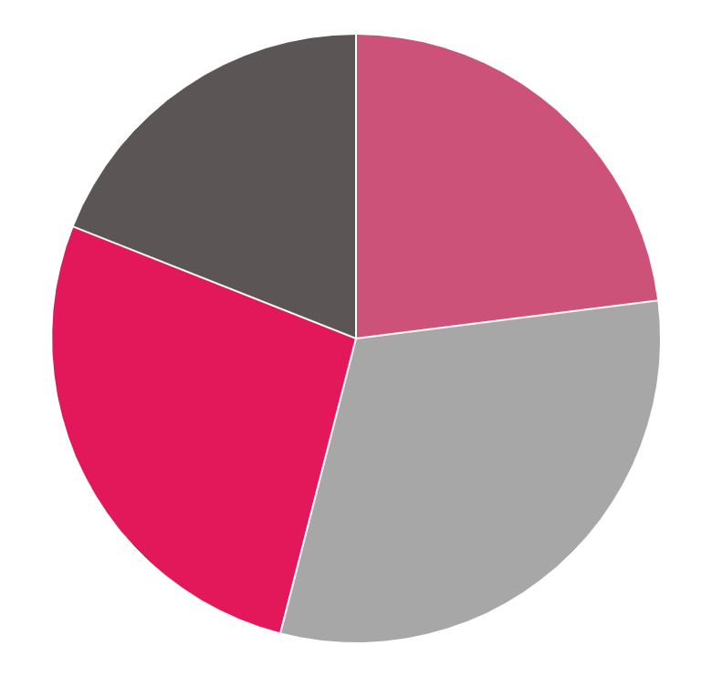
Use of Funds
19%
23%
Maintenance
Local Outreach
Making sure servers stay updated and website is functional.
Meeting with local venue owners, event planners.
28%
31%
R&D
Marketing
Perfecting the itinerary planning algorithm and creating the best possible UI
Enabling building a customer base and establishing brand familiarity

Slide 13
Financial Projections
Item | Year 1 | Year 2 | Year 3
Average ticket price (INR) | 500 | 600 | 700
Commission rate | 10% | 12% | 15%
No. of events listed | 1000 | 2000 | 3000
Average no. of tickets sold per event | 100 | 150 | 200
Advertising revenue (INR) | 5,00,000 | 10,00,000 | 20,00,000
Premium services revenue (INR) | 1,00,000 | 2,00,000 | 3,00,000
Commission-based revenue (INR) | 5,00,000 | 10,80,000 | 21,00,000

