Slide 1
Anusha Narayanan
Thrissur
anushanarayanan6492@gmail.com
9778057034
Manu Sankar P
Thrissur
manusankar030@gmail.com
9048849676

Slide 2
Manu Sankar P
CEO
Duties: Strategic Vision and Leadership , Business Development ,Operations Management, Stake Holder Communication.
Why Suited: Leadership Experience, Strategic Thinker ,Strong Communicator
Equity: 50%
Anusha Narayanan
Co-Founder
Duties: Product Development , Technical Expertise , Market Research and Client Relations.
Why Suited: Subject Matter Expertise in AI , Innovation and Analytical Skills
Equity: 50 %

Slide 3
Market need Assessment
Professionals in law, e.g. lawyers, will spend a lot of their time looking for cases similar to the one they are currently working on. The documents of these cases are called jurisprudence.
For ordinary people without legal background, the traditional information retrieval system that searches laws and regulations based on keywords is not applicable because they do not have the ability to extract professional legal vocabulary from complex case processes.
Currently, the search engines that exist for this purpose are not very user friendly and often limited to keyword searches.
The problem statement is to apply the legal recommendation analyzes the old cases to gain more insight into how judges interpret specific laws, and the cases also provide different points of view for a lawyer.

Slide 4
Product / Technology Overview
Interpret specific laws
Provide different points of view for a lawyer and law students
Simplified Language
Comprehensive Explanation

Slide 5
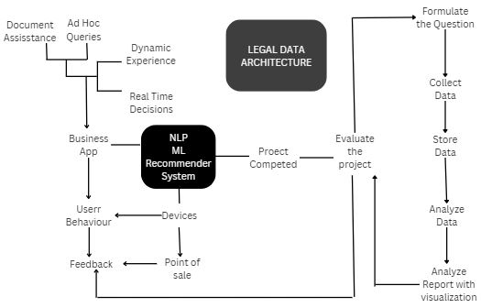
Business Model

Slide 6
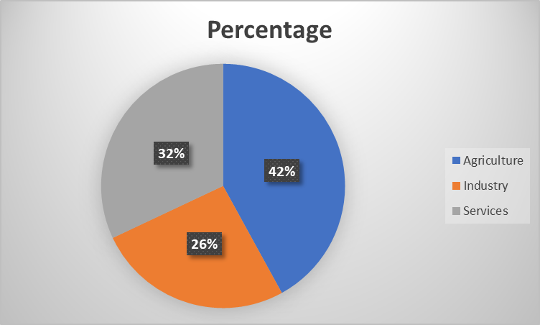
Size of the Market Opportunity
Lawyers -0.28%(1.4 million)-Lawyers' expertise is integral to every workforce sector, including agriculture, industry, and services, providing essential legal guidance and support.
Buyers
Legal Professionals: Lawyers, Paralegals,Judges and Research Institution.-Rs 1999 /year
General Public and Law Students.-Rs 799/year.

Slide 7
Current Traction
Implementation of web scraping using Scrapy.
Researching on Recommendation Systems.
Discussing on what all features to be added.

Slide 8
Competitive Landscape
Competitors :
LegalRobot
DoNotPay
AILawyer
Casetext
Latch
How to Compete:
Accessibility and Affordability
User Experience
A unique law recommendation
Using Artificial Intelligence and Machine Learning
Integration and collaboration with Law Schools

Slide 9
Financial Current and Projections
Summary of Business Plan for 3 Years
Year 1: Development and Market Entry
Goals: Develop the core technology and features of the app.Conduct beta testing with a select group of users. Launch marketing campaigns to create awareness.Onboard initial users and generate early revenue.
Year 2: Growth and Expansion
Goals: Expand user base through targeted marketing and partnerships.Enhance app features based on user feedback. Improve AI algorithms for more accurate recommendations.Scale operations to handle increased user traffic.

Slide 10
Financial Current and Projections
Year 3: Market Leadership
Goals:Achieve significant market penetration and brand recognition.Introduce premium features and services.Optimize revenue streams and profitability.Expand to additional regions and market segments.

Slide 11
Capital Expenditures (CAPEX):
Year 1:
Technology Development: ₹1 Crore
Infrastructure Setup: ₹35 Lakh
Initial Marketing and Branding: ₹35 Lakh
Year 2:
Feature Enhancements: ₹70 Lakh
Scaling Infrastructure: ₹35 Lakh
Market Expansion: ₹52.5 Lakh
Year 3:
Advanced AI Development: ₹1.05 Crore
Geographic Expansion: ₹70 Lakh
New Product Lines: ₹52.5 Lakh

Slide 12
Funding Needs, Use of Funds & Proposed Valuation
Total Amount to Raise: ₹10 Crore
Technology Development and Enhancements: ₹3 Crore
Marketing and User Acquisition: ₹3 Crore
Operational Costs: ₹2 Crore
Expansion and Scaling: ₹2 Crore
Currently, there are no co-investors committed.
Duration of Funds: 18 months
Expected Achievements:
User Base: Grow to 50,000 active users
Revenue: Generate ₹7.5 Crore in revenue
Market Penetration: Establish a strong presence in major cities and expand to tier-2 and tier-3 cities
Product Development: Launch premium features and enhanced AI capabilities
Future Funding Needs: Post this initial funding, we plan to raise a Series A round of ₹15 Crore .
Purpose of Series A: Further market expansion, advanced AI development, and scaling operations to accommodate a larger user base.
Proposed Valuation
Valuation for This Round: ₹30 Crore

Slide 13
Current Equity Structure, Fundraising History, and Investors
Currently no investors.

Slide 14
Exit Options
Acquisition by Larger Legal Tech Firms:Potential Buyers: Established legal tech companies such as LexisNexis, Thomson Reuters (Westlaw), or Indian companies like Manupatra and CaseMine. Rationale: These companies might acquire the app to integrate advanced AI capabilities, expand their user base, and enhance their product offerings.
Initial Public Offering (IPO):Potential Market: Indian stock exchanges such as BSE or NSE. Rationale: If the app achieves significant market penetration and revenue growth, an IPO could be a viable exit strategy, providing liquidity to early investors and access to a broader capital base.
EXAMPLES:CaseMine Acquisition by Manupatra (2018), Ravel Law Acquisition by LexisNexis (2017)

