Slide 1
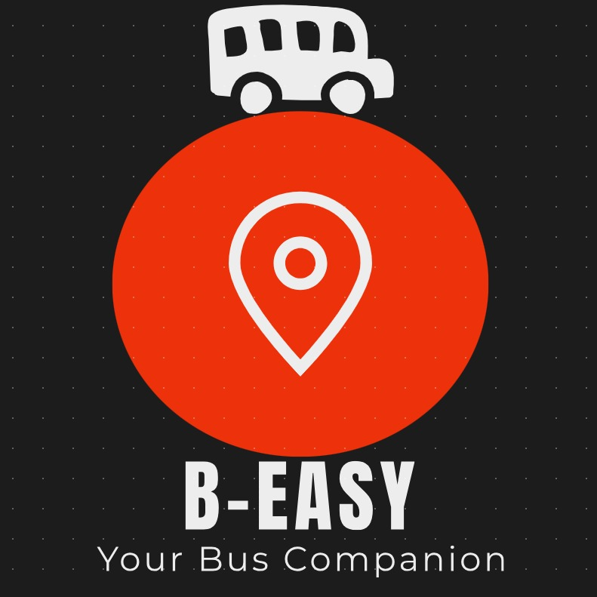

Slide 2
Meet the Team
Sanika Jogipethkar
Shruti Keskar
Jaitirth Page

Slide 3
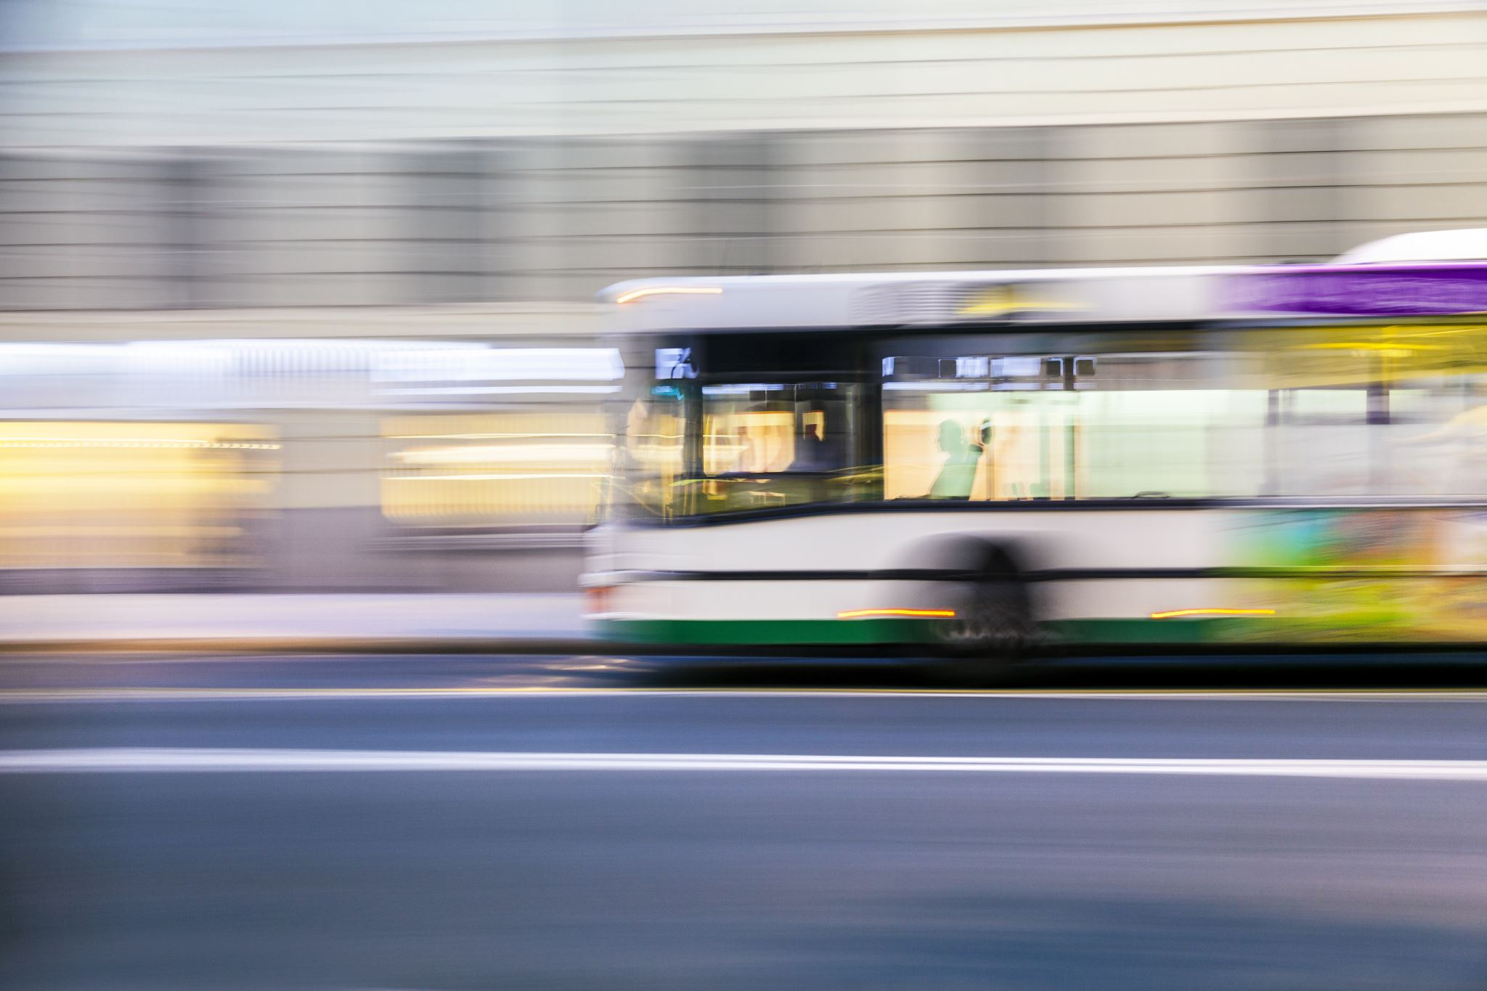
Current Problems Faced
Public transport issues:
Unknown routes.
Inaccurate schedules of public transport buses in a city.
Lack of updates about location and timings of the public transport bus and crowd.
Uninformed delays and cancelations.
Lack of information of connectivity.

Slide 4
Our Survey
According to our survey in Pune :
The percentage of people facing the following problems are:
Inaccurate schedule : 78%
Overcrowding : 89%
Uninformed frequency issues : 81%
Long waiting time : 64%
Unsure about routes : 61%

Slide 5
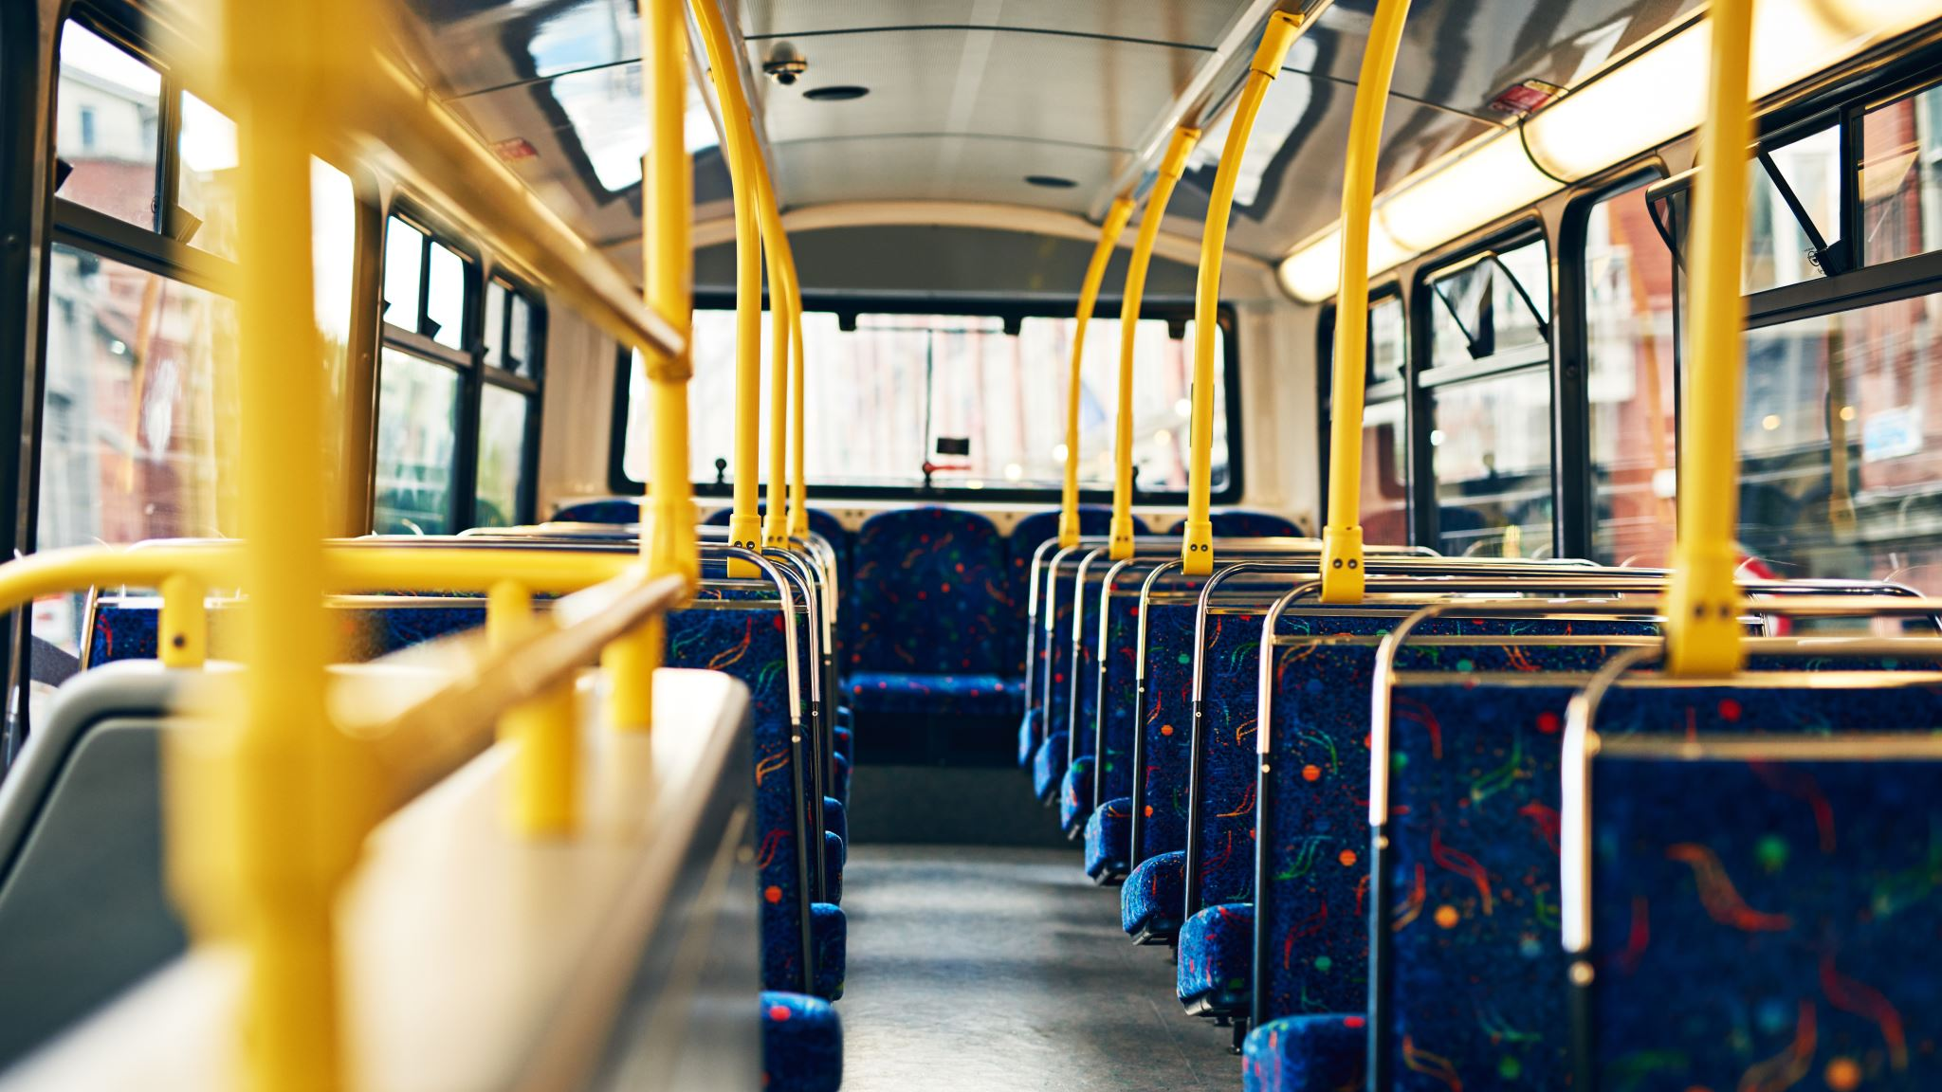
Solution
B-easy
An app that provides updates about bus routes, timings, schedule and live tracking of the bus.

Slide 6
Our Technology
Display of schedules of buses.
Live tracking of buses through GPS.
Crowding updates through polls (collected from users).
Online tickets and passes.
Suggestion of efficient routes.

Slide 7
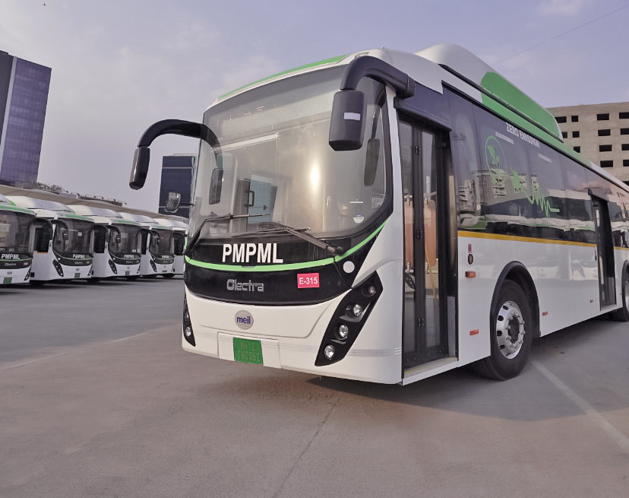
Suggestion of routes will be done in 2 ways
Direct buses with waiting time and frequency
Connecting buses with waiting time, frequency, and additional cost if any.

Slide 8
Business Model for Revenue generation
Advertisements
Premium Subscription :
Benefits :
Ad-free
Discount opportunities on online passes.
Through tie ups with city public transport bus organisation ( Eg.: PMPML in Pune)

Slide 9
Customer Segmentation

Slide 10
Targeted Customer Segment
Students
Working Professionals

Slide 11
Marketing Strategies:
Social Media marketing: Instagram, Facebook , YouTube
Pamphlets in buses
Publicity in Schools, Colleges and Workplaces.

Slide 12
Our Competitors
Google Maps
Moovit
Google maps
Moovit
These apps track the buses on the basis of their hard-coded schedules with respect to time. And suggests routes of connecting without information of waiting time.
B-easy

Slide 13
How is B-easy different?
Live tracking of buses through GPS is more reliable.
Any changes in the time and route are updated instantly.
Provides with crowd status of buses.
Provides with various routes along with connecting routes with its waiting time and pricing

Slide 15
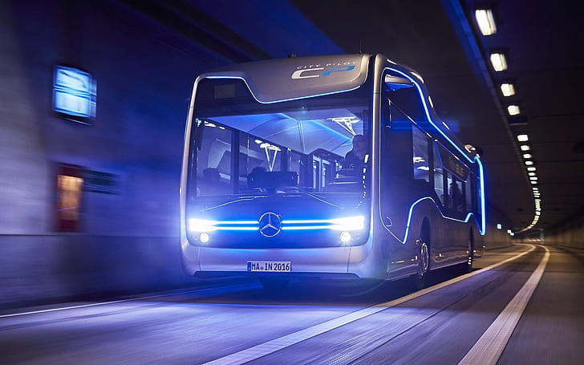
Thank you

